Slide 1
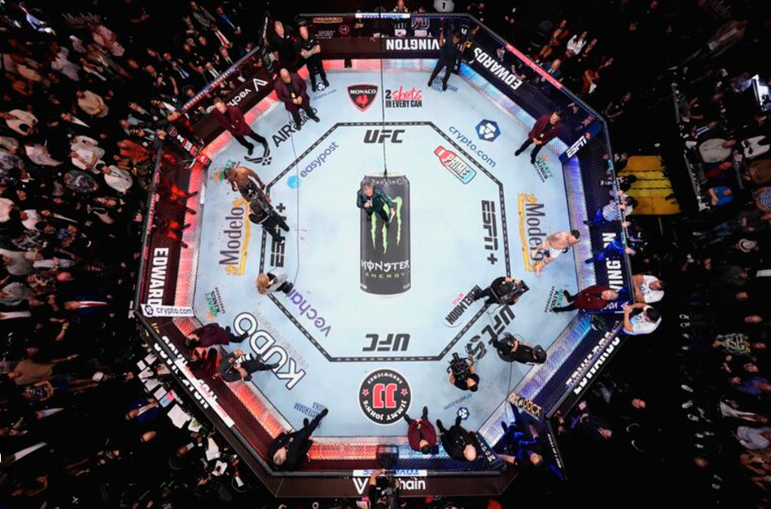
UFC
Red VS Blue
By Group 5

Slide 2
Background
The Sport of MMA, popularized and facilitated by the UFC, is a full-contact combat sport that allows a wide variety of fighting techniques and skills from a mixture of other combat sports to be used in competition. The rules allow usage of both striking and grappling techniques while standing and on the ground. Competitions allow athletes of different disciplines of martial arts to compete under a set of unified rules. In the ring, fighters are placed in either the blue or red corner. The fighter with the higher record will walk out second and tends to be in the red corner, while the lower ranked fighter will walk first and take the blue corner.
Notes:
Good yapping material. Talk more about this if you feel like you will go too quickly

Slide 3
Terminology
Methods of Victory
Submission (SUB): Physical or verbal tap out
Knockout (KO): Athlete is knocked unconscious
Technical Knockout (TKO): The referee stops the contest due to strikes or impact
Judges' Decision (U-Dec, S-Dec): Fight is not finished by a submission, KO, or TKO, and judges deliver their scorecards for a final decision
Terms to Know
Unanimous: All judges pick the same athlete as the winner
Split: One judge picks one athlete. The other two judges pick the other athlete
Majority: Two judges pick the same athlete as the winner but the final judge says fight was a draw
Draw: Unanimous, majority or split
Notes:
Briefly cover this as these factors arent seen much in the data

Slide 4
Data Shorthand
Str: Strike
Sig: Significant
Sub: Submission
Pct: Percent
Avg: Average
Dif: Difference
TD: Take-down
Att: Attempt
Notes:
Just list these out…”you might see these show up later in the project” yada yada

Slide 5
Objective
To design and implement a predictive model that analyzes fight statistics to predict the outcome of UFC matches , where resampling is used to address imbalances in the dataset. The model focuses on determining whether the fighter in the red corner, who is assigned based on having a higher win record compared to their opponent in the blue corner, is more likely to win the fight. By leveraging comprehensive fight statistics—such as strike accuracy, grappling success, defense rates, and previous match outcomes—the project aims to identify key performance indicators that contribute to victory. This model will provide insights into competitive advantages, trends, and the relative importance of fight metrics in determining match outcomes.
Notes:
-The goal is to predict if the red corner fighter is more likely to win.
-Focus on fight stats like strikes, grappling, defense, and past wins.
-Use resampling to fix uneven data and improve accuracy.
-Find key stats that help fighters win and spot patterns in matches.

Slide 6
Cleaning the Original Dataset
Filtering Messy Data:
Missing Data
Removed features with excessive missing data by implementing a threshold, where columns with more than 20 percent missing values were removed.
For the remaining columns, missing values were replaced with their columns mean value .
Excessive Zeros
Columns with more than 80 percent zeros were treated as missing, as no valuable information could be gained from these columns.
Discretionary Feature Removal:
Time Window Restriction
To insure insights were relevant to the current state of UFC, and to eliminate any influence of time as it relates to the features of the dataset, the time window was restricted to data from 2023-2024.
Categorical Data
Many categorical columns were irrelevant to the results of the fight (like Location and EventName).
Categorical data is less suited for use in our models.
Response Column
The response column was converted to binary (1 for red win, 0 for blue win) for model suitability.
Notes:
Removed columns with over 20% missing values; filled remaining missing values with column means.
Treated columns with more than 80% zeros as missing and removed them.
Restricted the dataset to 2023-2024 to ensure relevance to current UFC trends.
Removed irrelevant categorical features, such as Location and EventName.
Converted the response column to binary: 1 for red win, 0 for blue win.

Slide 7
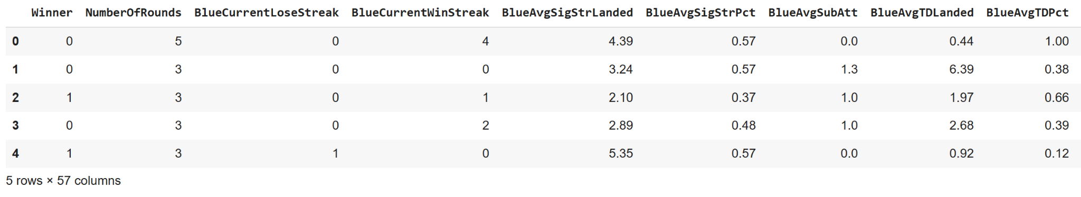
Cleaned Dataset
Notes:
The dataset includes key fight metrics like win streaks, strikes landed, and grappling success.
"Winner" is the target variable, binary-coded (0 = Blue win, 1 = Red win).

Slide 8
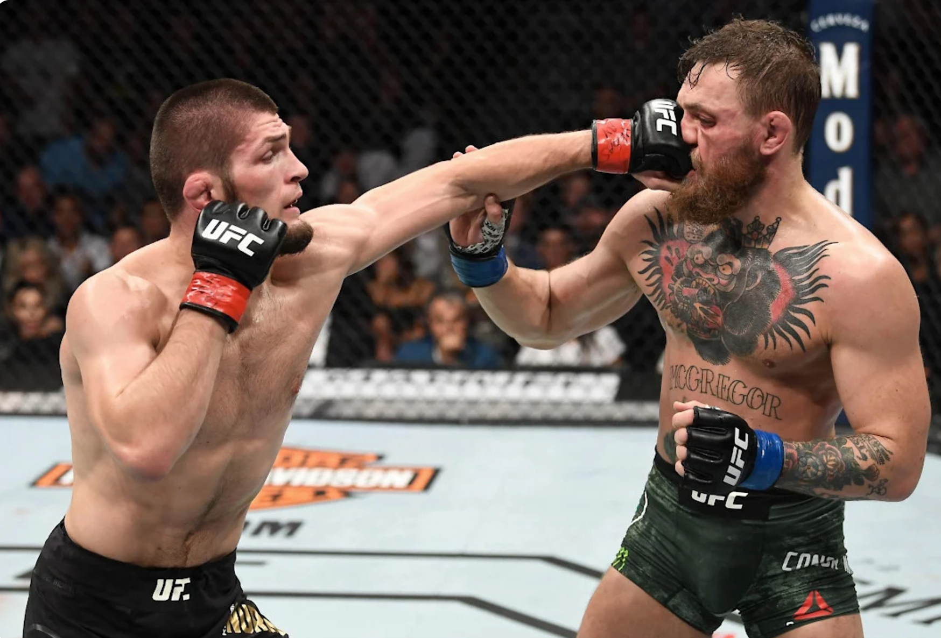
Exploratory Data Analysis
After cleaning the data, we look at which of the remaining features are most important for analysis.

Slide 9
Continuous and Discrete Variables
Continuous Variables: BlueCurrentWinStreak, BlueAvgSigStrPct, BlueAvgTDLanded, RedLosses, etc.
Discrete Variables: NumberofRounds, BlueCurrentLoseStreak, BlueWinsByDecisionSplit, etc.
We decided to remove discrete features (defined as columns with less than 10 unique values) because they can have little variation and prediction power. Removing them can reduce noise and prevent overfitting in our models.
Notes:
Continuous features like win streaks and strike percentages were kept for better prediction.
Discrete features with fewer than 10 unique values were removed to reduce noise.
This helps avoid overfitting and focuses on more impactful variables.

Slide 10
Determining Statistical Significance of Predictors
Statistical Testing:
The relationship between each feature and the target variable (Winner) was tested using statistical methods like the t-test
Evaluating p-values:
Features with p-values below a chosen threshold (0.05) were considered statistically significant and retained
Features with high p-values were considered weakly related to the target and removed
Notes:
Tested the relationship between each feature and the target variable using t-tests.
Retained features with p-values below 0.05 as statistically significant.
Removed features with high p-values due to weak correlation with the target.

Slide 11
The Random Forest Algorithm
Random Forest as a Feature Evaluator
We can use Random Forest to evaluate how useful each feature is in addition to making predictions
Importance is calculated based on its contribution to reducing impurity in the decision trees, where at each split, features that consistently split the data well (leading to purer subsets) are considered more important.
Feature Importance Reflects Predictive Power
Higher importance scores mean the feature is more useful for splitting the data and improving model accuracy
Features with very low importance scores can be removed to simplify the dataset without significantly affecting model performance
The Result
We chose the ten features with the highest importance score

Slide 12
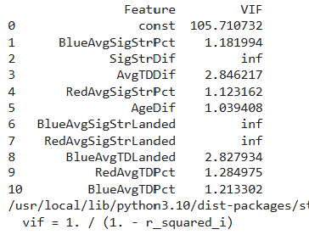
Variance Inflation Factor
Checks for multicollinearity (when features are highly correlated with each other)
The higher the VIF score the greater the correlation with the other variables
Variables with inordinately high VIF scores were removed
Notes:
Read of side notes for this one

Slide 13
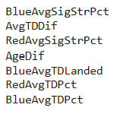
The Results
After implementing our feature selection tests, we are left with the following predictors:
Notes:
When you list these out say the full variable name eg blue average significant strike percent

Slide 14
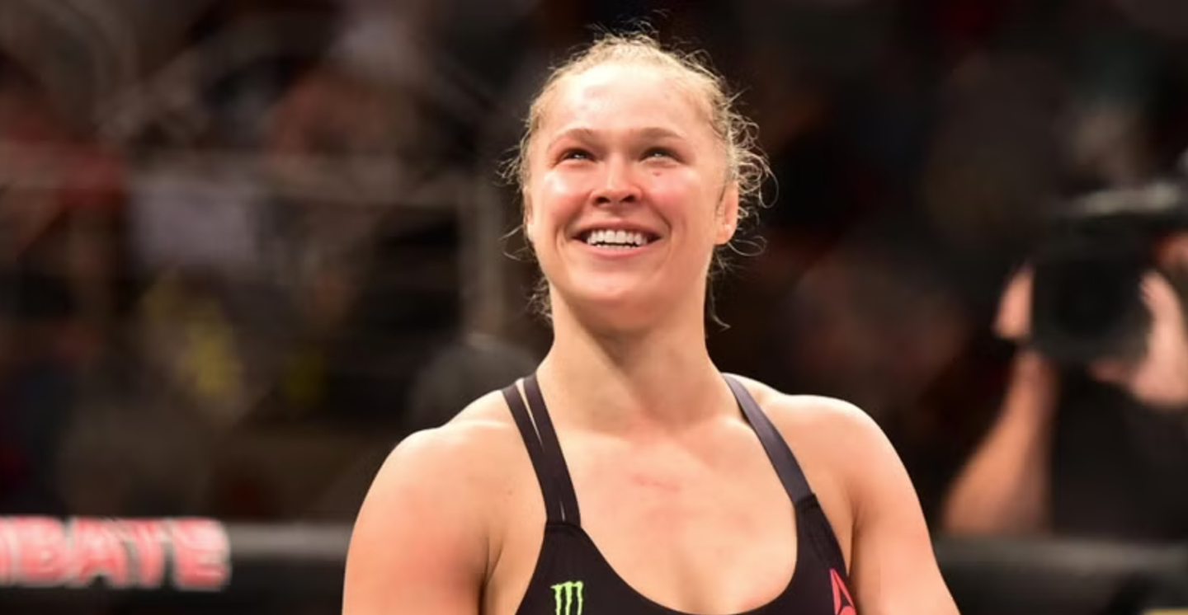
Graphs
Visualizing the most important predictors to better understand their relationship with the response variable

Slide 15
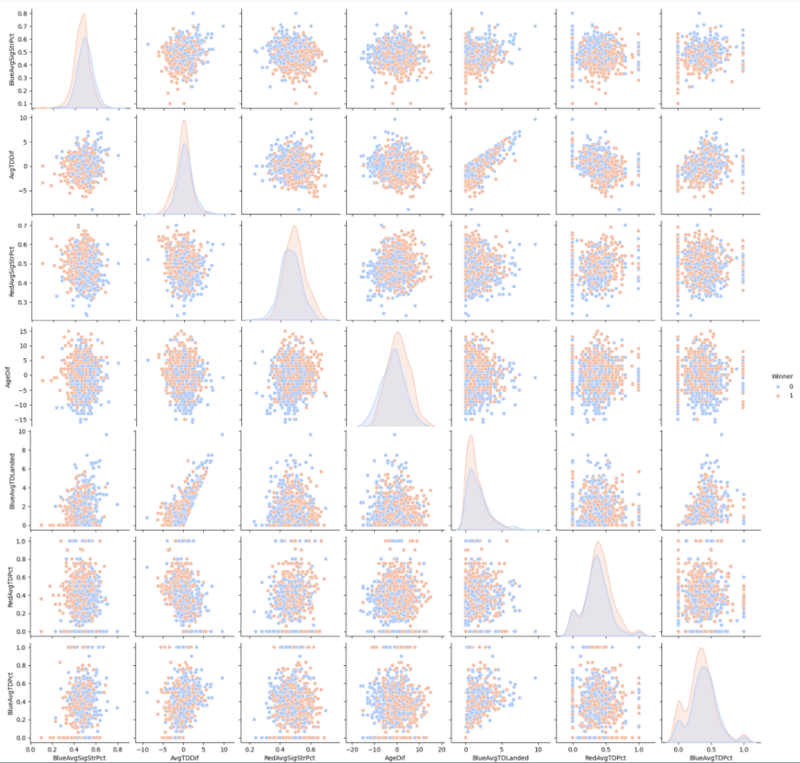
PairPlot
AvgTDDif and BlueAvgTDLanded have the strongest linear relationship
If one color dominates in specific regions, it suggests a strong relationship with the outcome.
Both red and blue winners are somewhat evenly matched within each variable

Slide 16
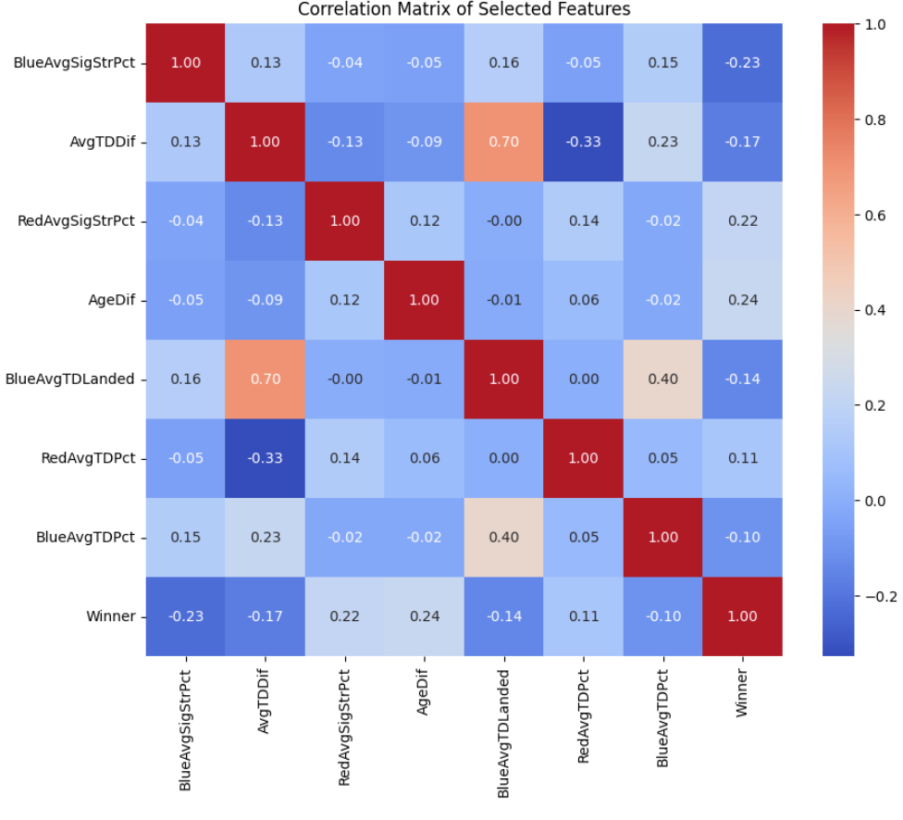
Heat Map
Winner has no clear correlation with other variables
The only variables with notable correlation are ones that we would expect to be highly correlated, and thus do not provide much insight, such as BlueAvgTDLanded and AvgTDDif
Overall the data has very little correlation
Notes:
"Winner" has no strong correlation with other features.
Some variables, like BlueAvgTDLanded and AvgTDDif, show expected correlations.
Overall, the dataset has low correlations.

Slide 17
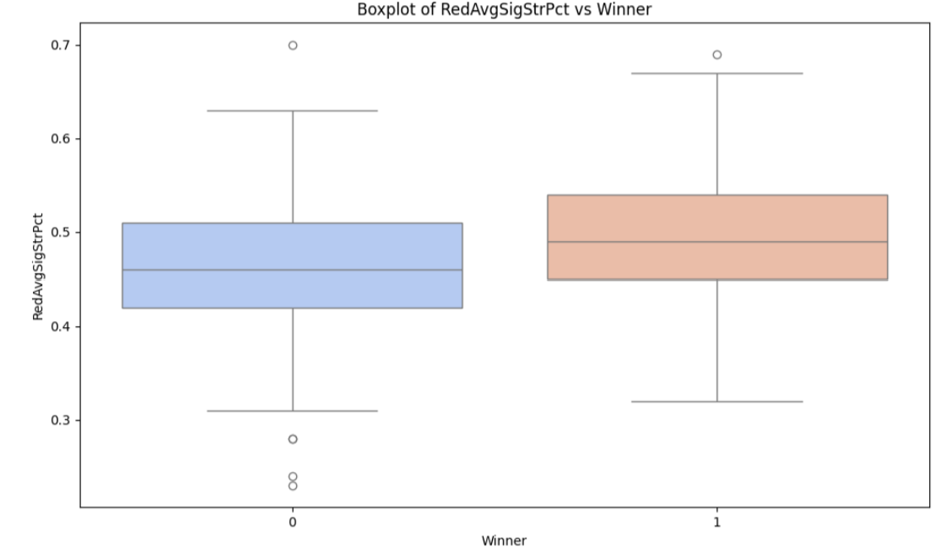
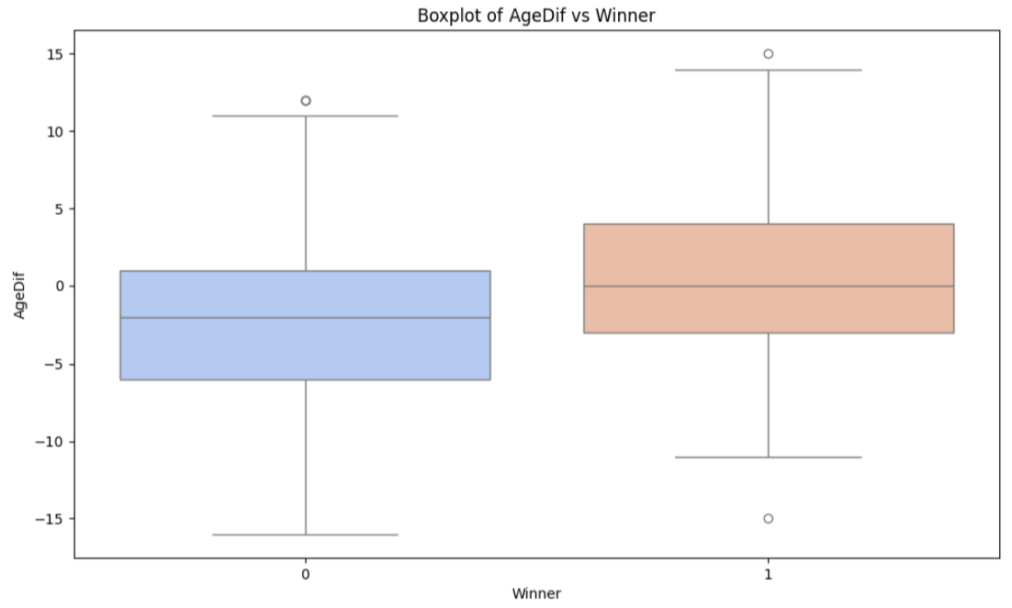
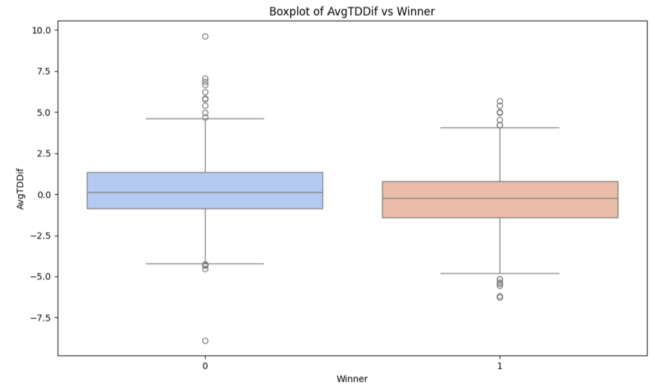
Box Plots
Notes:
Box plots compare key features like strike accuracy and takedown rates against the target variable (Winner).
Red winners (1) show slightly higher values for some metrics, like RedAvgSigStrPct and RedAvgTDPct.
Differences in metrics like AgeDif and AvgTDDif are minimal, indicating limited impact.

Slide 18
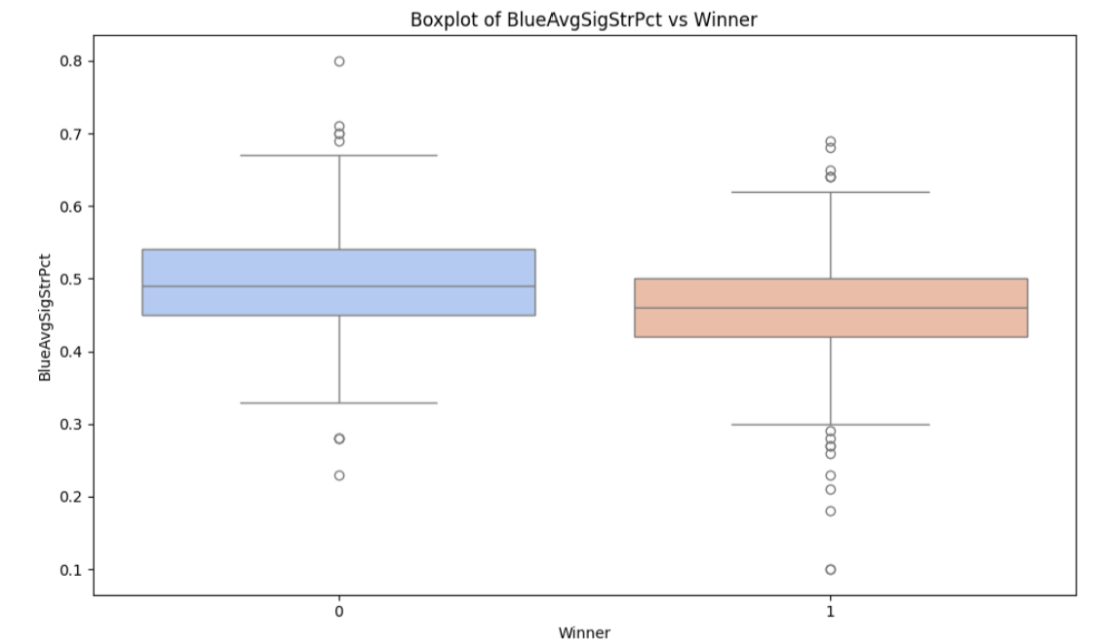
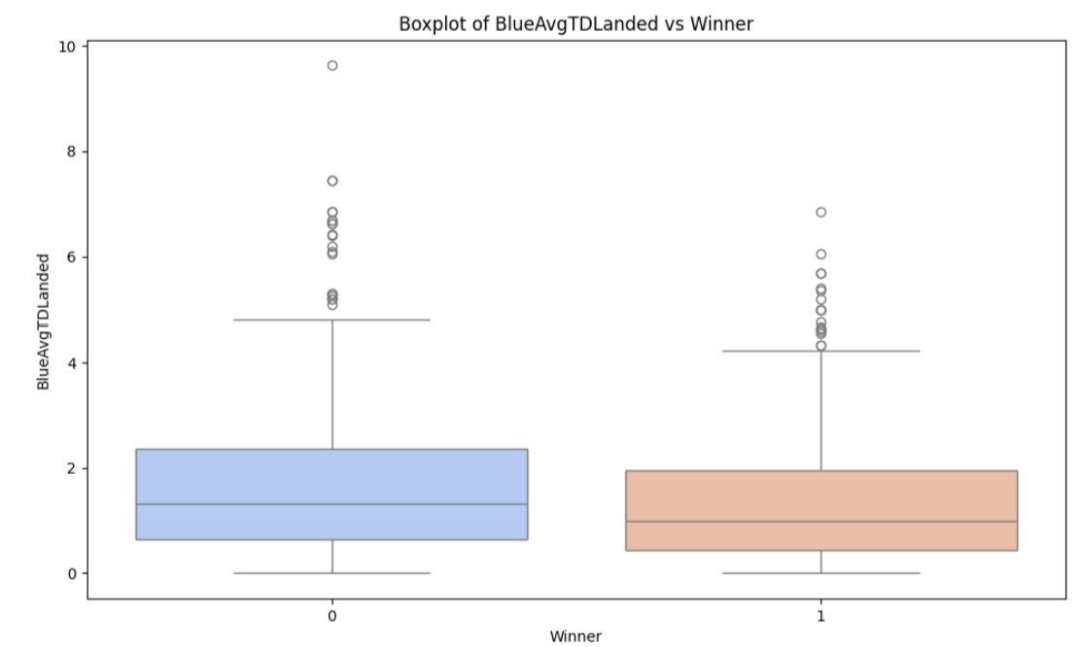
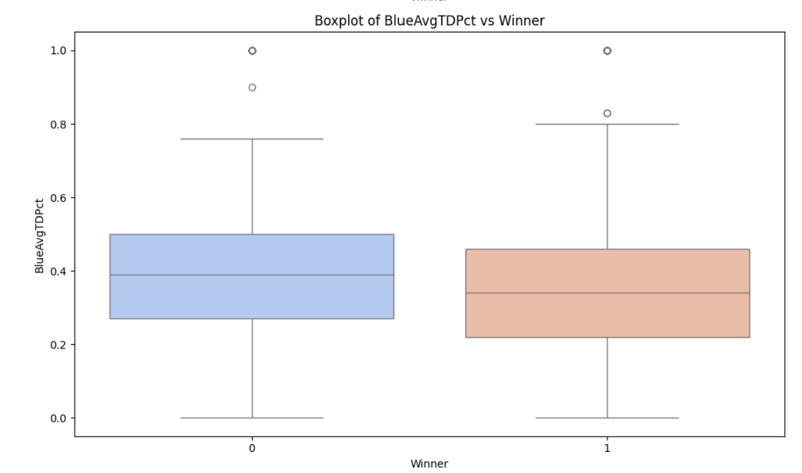
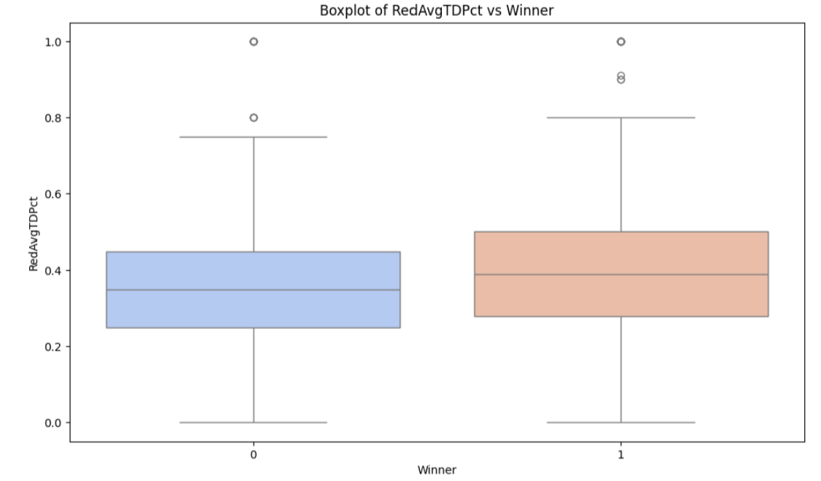
Box Plots (cont.)
Notes:
Box plots compare key features like strike accuracy and takedown rates against the target variable (Winner).
Red winners (1) show slightly higher values for some metrics, like RedAvgSigStrPct and RedAvgTDPct.
Differences in metrics like AgeDif and AvgTDDif are minimal, indicating limited impact.

Slide 19
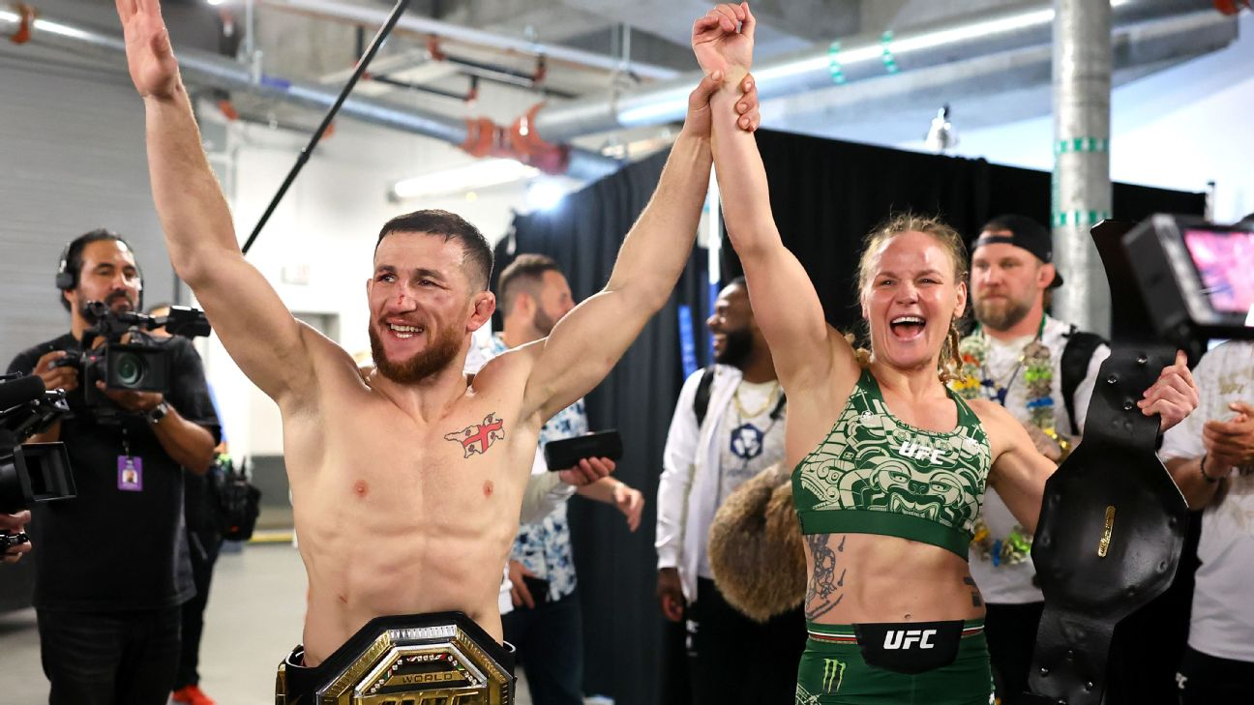
The Model

Slide 20
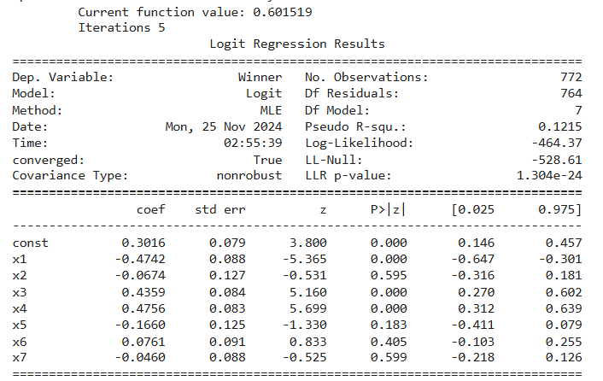
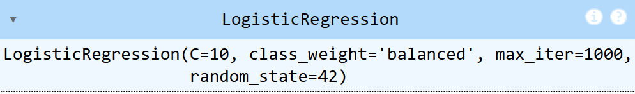
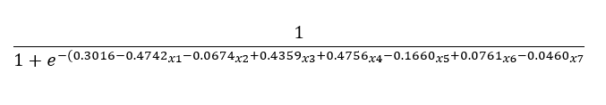
Logistic Regression Model
x1​ (strong negative impact), x3, and x4​ (strong positive impacts) are the most important features influencing fight outcomes.
x2​, x5​, x6​, and x7 are statistically insignificant and could be removed for simplicity.
Pseudo R-squared: 0.1215 (moderate predictive power)
Class imbalance addressed with class_weight='balanced'
Notes:
Read off slide
Psuedo R-Squared good model between 0.2-0.4 (that’s why ours is moderate)

Slide 21
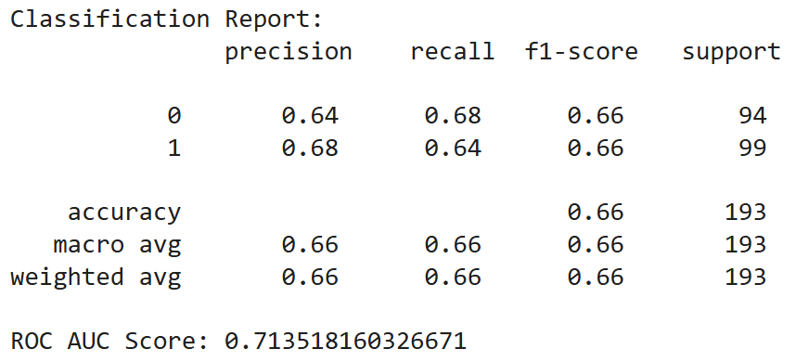
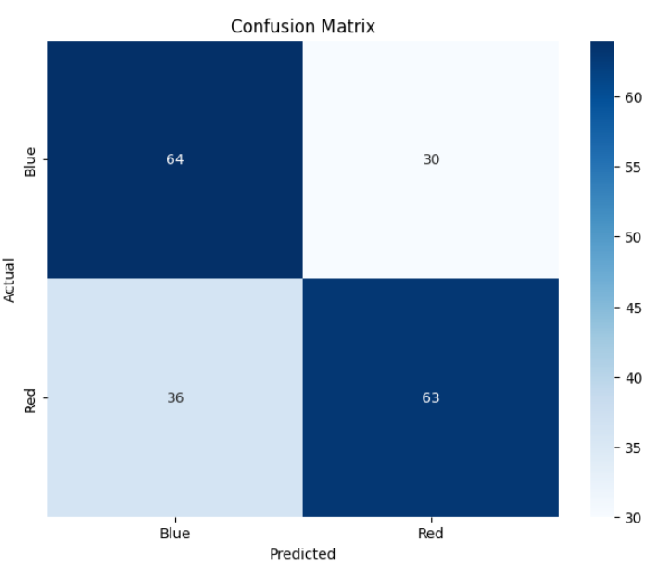
Accuracy Report and
Confusion Matrix
The accuracy of the model is 66% with an AUC score of 0.7135, indicating a fair performance.
This is a lot better than just random guessing.
Notes:
Read of the slide

Slide 22
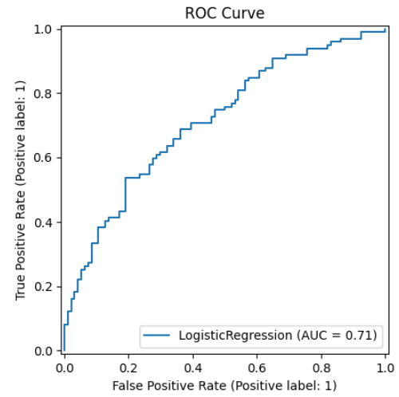
ROC Curve
The curve is above the diagonal (random guessing line), which means the model performs better than random.
However, the AUC of 0.71 suggests room for improvement. Values closer to 1 represent better performance.

Slide 23
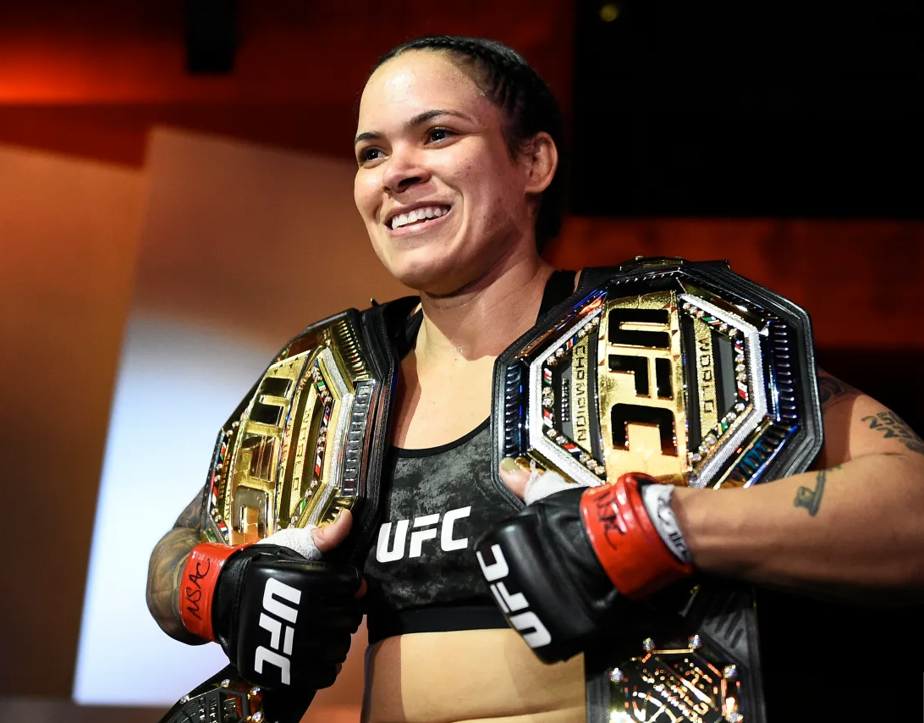
Resampling

Slide 24
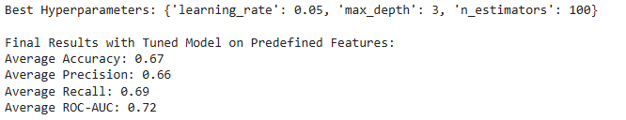
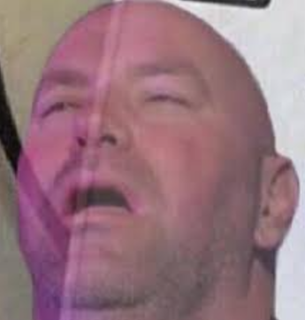
Model Tuning
To tune the model we will be implementing multiple techniques to increase overall accuracy average, precision, and recall of the model as well as model performance.
To start we will standardize the data to avoid zero mean.
We then move on with handling class imbalance with SMOTE (oversamples the minority class by creating synthetic data points rather than duplicates)
Then set up stratified K-Fold Cross Validation (ensures each fold is represented)
Then define the hyperparameter grid for tuning
Add a Gradient Boosting Classifier to the grid search initialization
Then evaluate overall model using Stratified K-Fold
For the future: To increase accuracy, precision, recall and model performance we will adjust number of folds and possibly use different models like XGBoost or SVM. Stacking could possibly help as well (combining multiple models)

Slide 25
Modeling Outcomes in Sports
Nature of UFC fights
UFC fights are inherently unpredictable due to the variety of fighting styles, strategies, and external factors like fatigue
Other Sports
In sports with more structured dynamics like football and basketball, models rarely exceed 85% - 95% accuracy.
Real World Value
For applications like betting, improving accuracy even marginally over 50% can lead to significant advantages
Using our model, we were able to demonstrate a 34% improvement over a random classifier, which in the context of sports prediction is fairly reasonable

Slide 26
Conclusion
Based on our data there is no strong correlation with winning and any of our other variables. However, we were able to build a model with fair performance in the context of sports modeling by using feature selection and resampling.
Current limitations:
Accuracy score is low (67%)
Too many factors
No clear predictors of Winner based on heatmap/ correlation
Messy Data took a lot of time to clean
Next Steps:
Continue to work on our model and see if we can further improve accuracy
Reduce redundancy in data by combining common features and potentially doing some simple feature engineering
Combine multiple models (stacking)
Update hyperparameters and number of folds

Slide 27
References
https://www.geeksforgeeks.org/data-visualization-with-pairplot-seaborn-and-pandas/
https://www.statology.org/sklearn-classification-report/
https://www.geeksforgeeks.org/confusion-matrix-machine-learning/
https://www.appstate.edu/~whiteheadjc/service/logit/intro.htm
https://ca.novibet.com/blog/top-best-ufc-fighters-of-all-time
https://www.givemesport.com/the-10-greatest-ufc-womens-fighters-of-all-time-ranked/
https://talksport.com/mma/1746424/greatest-ufc-fighters-ever/
https://www.kaggle.com/datasets/mdabbert/ultimate-ufc-dataset/data
https://www.ufc.com/news/dangerous-uriah-hall-relishes-weidman-rematch-ufc-261
https://fansidedmma.com/posts/red-blue-corner-fan-guide-01hvkvq95pp8
https://www.ufc.com/octagon
https://online.stat.psu.edu/stat462/node/180/
https://pmc.ncbi.nlm.nih.gov/articles/PMC8831439/#:~:text=The%20ROC%20curve%20is%20an,or%20absence%20of%20a%20disease.

